Slide 1
Lecture 7: Intro to Python & Pair Programming
CSC111: Introduction to CS through Programming
R. Jordan Crouser
Assistant Professor of Computer Science
Smith College

Slide 2
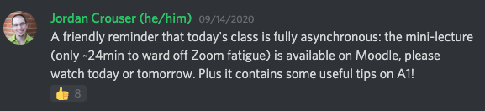

Announcements 1/3
not hugely informative…

Slide 3
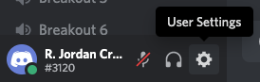
Announcements 1/3

Slide 4
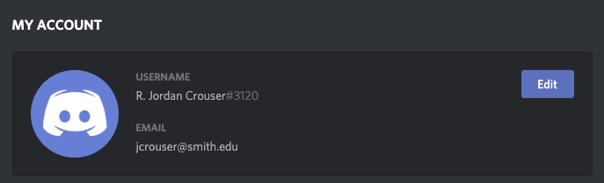
Announcements 1/3

Slide 5
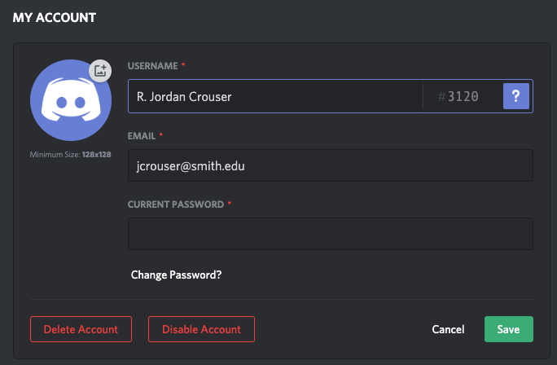
Announcements 1/3

Slide 6

Announcements 1/3

Slide 7
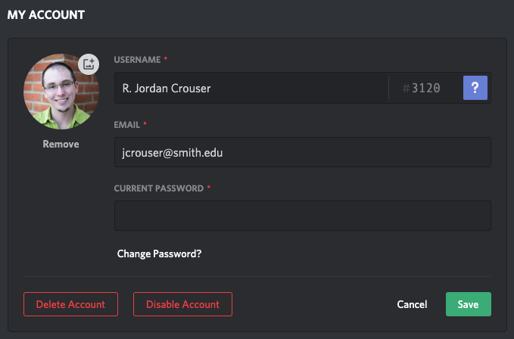
Announcements 1/3

Slide 8
Announcements 1/3
much better!

Slide 9
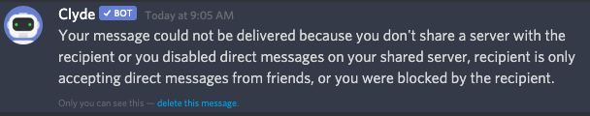
Announcements 2/3
if you use Discord in other contexts
and have your account set to block DMs,
consider adding the instructors / TAs
so we can contact you directly

Slide 10
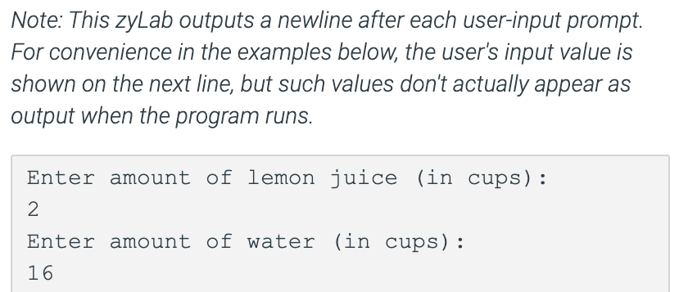
Announcements 3/3

Slide 11
Announcements 3/3

Slide 12
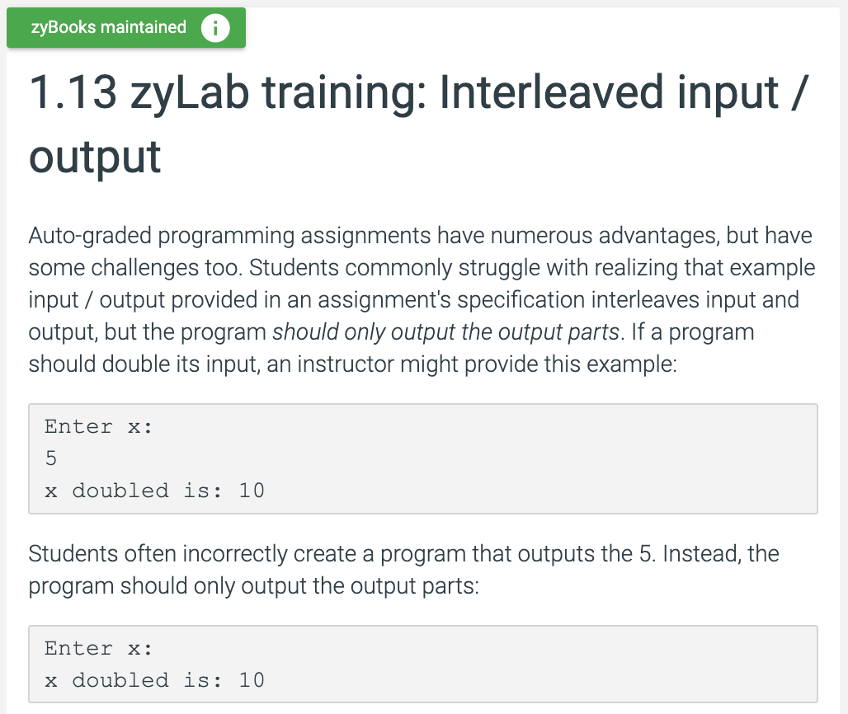
Announcements 3/3
Still confused? Revisit 1.13!

Slide 13
Overview of the week
Monday: more mathematical operators
Revisiting ints and floats
The math module
Formatting
Lab: fun with math (debrief)
Wednesday: Life Skill #1: Pair Programming
Friday: Strings and string methods

Slide 14

Discussion
What approach did you take to
working on Lab 2?
Was it successful?

Slide 15
Overview of the week
Monday: more mathematical operators
Revisiting ints and floats
The math module
Formatting
Lab: fun with math (debrief)
Wednesday: Life Skill #1: Pair Programming
Friday: Strings and string methods

Slide 16
The programming process

Slide 17
The programming process (idealized)

Slide 18
The programming process (idealized)

Slide 19
The programming process (idealized)

Slide 20
The programming process (idealized)

Slide 21
The programming process (idealized)

Slide 22
The programming process (more realistic)

Slide 23
Getting started

Slide 24
“S⁴”: start small | slow | simple

Slide 25
Next: address the constraints

Slide 26
Add additional features

Slide 27
Finally: hit target

Slide 28
Discussion
So what does this
look like in practice?

Slide 29
A problematic (but common) model

Slide 30
A better model: “pair programming”
two
people
one
machine

Slide 31
Two complimentary roles
driver
navigator

Slide 32
A common analogy
driver
navigator

Slide 33
Navigator vs. driver: different focus
“what”
“how”
“why”

Slide 34

A professional perspective (& some tips)

Slide 35
Reality check
What makes this approach
so hard?

Slide 37
Pair programming “mini-project”
Notes:
Demo

Slide 38
Suggestions
Start on the whiteboard, not the computer
Identify the key components (what do you need?)
Pseudocode
Remember: S⁴
Switch roles frequently (~25 minutes)
Take short (<5 minute) breaks between switches
repl.it/@JordanCrouser/old-macdonald

Slide 39
Great things I overheard during pairing…
“Does that make sense?”
“How did you know?!”
“Yeah, but it’s not supposed to…”
“These don’t change, right?”
“Let’s come back to this…”
“Oh, so then we can do what we did before…”
“Hey, we’re making some progress!”

Slide 40
Takeaways
How did today feel?
What did you notice?

Slide 41
Overview of the week
Monday: more mathematical operators
Revisiting ints and floats
The math module
Formatting
Lab: fun with math (debrief)
Wednesday: Life Skill #1: Pair Programming
Reminder: A1 due Thursday at 11:55pm EST
Friday: Strings and string methods

